Slide 1
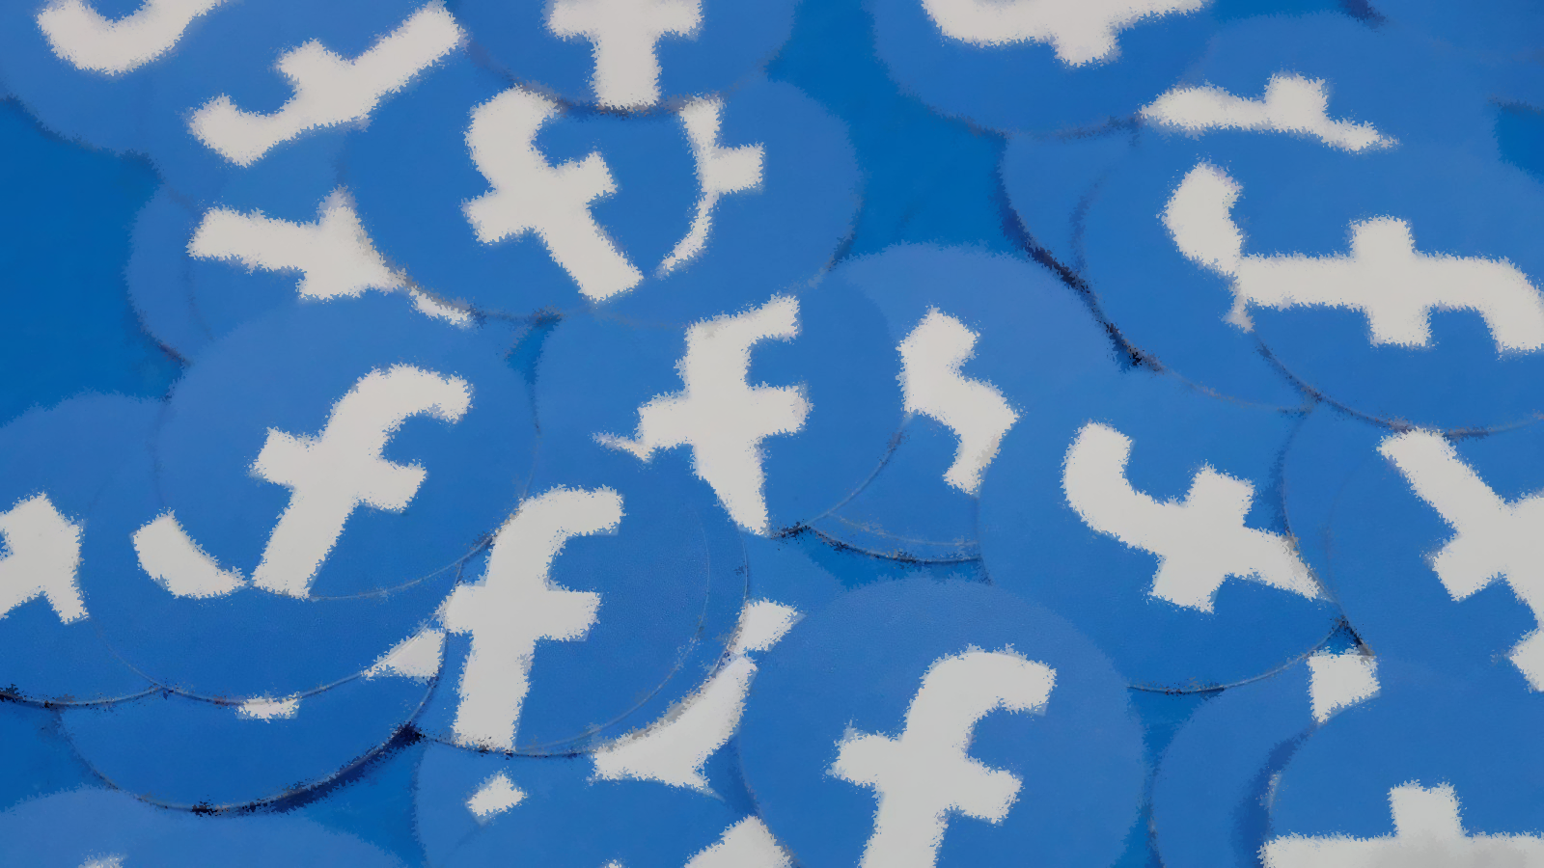

Politics, candidate Advertising, and Facebook
Tina Tucker
Notes:
Welcome to my final project on political advertising on Facebook. In this project, I investigate which kinds of political candidates are most likely to devote resources to digital advertising in modern campaigns.

Slide 2
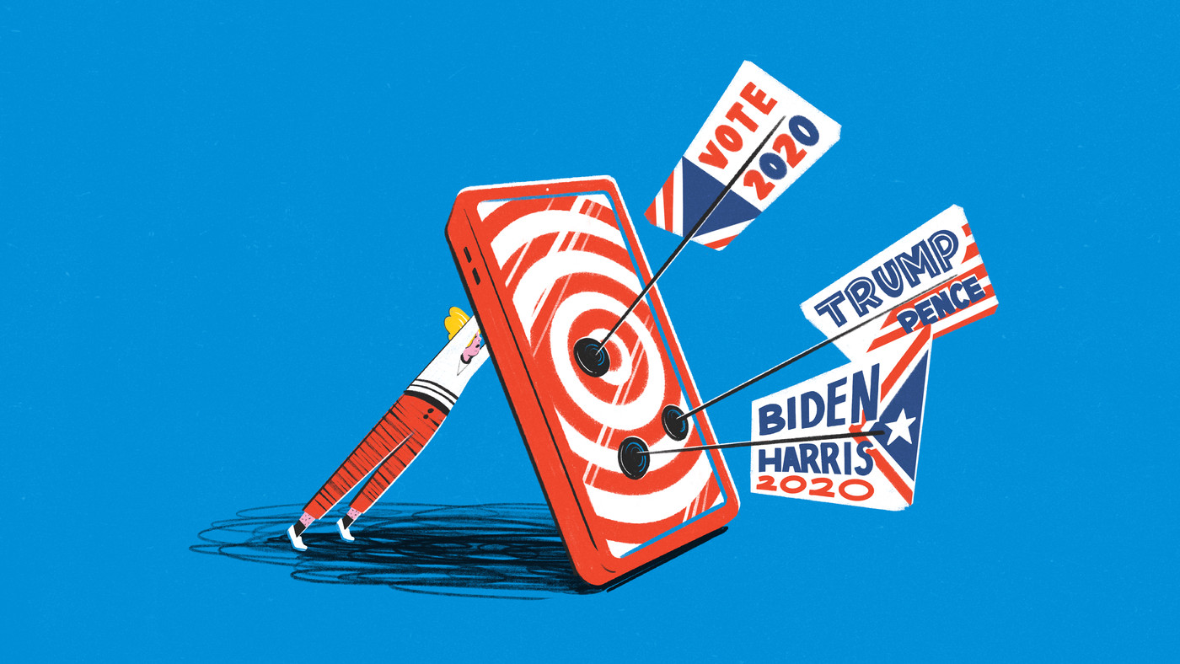
Spending on digital political ads is increasing every election cycle
Notes:
Spending on digital political ads is increasing every election cycle. Although television advertising continues to dominate campaign spending -- for the 2020 election, spending on digital ads climbed to over 3 billion dollars. Much of this total was spent on social media advertising, where the major platforms make it easy, cheap, and efficient for candidates to reach voters.

Slide 3
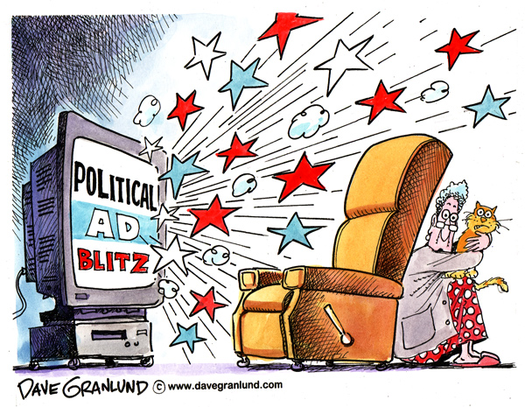
But everything we know about political ads comes from the study of advertising on Television
Notes:
The problem is… all our empirical knowledge about political advertising comes from the study of TELEVISION advertising.

Slide 4
Research finds that tv political advertising is unbalanced ACROSS ELECTORAL RACES
CLOSE AND COMPETITIVE
INCUMBENCY ADVANTAGE
NO PARTISAN DIFFERENCE
Notes:
Research on television advertising finds that….
It is concentrated in highly competitive races, where the outcome is uncertain and the margins are close.
It is also more common among incumbents who tend to have more cash on hand to purchase expensive TV ad slots.
It is balanced between between Republican and Democratic candidates. In other words, candidates from both parties tend to advertise on TV at similar rates.

Slide 5
But Digital ads differ from TV ads in fundamental ways…
INEXPENSIVE
INTERACTIVE
MICROTARGETED
Notes:
But digital ads are very different than television ads.
They are interactive, meaning you can click on them, share them, comment on them.
And they are microtargeted, meaning they can reach narrow slices of the electorate.
The big thing is that digital ads are so much cheaper than TV ads. $100 spent on a Facebook ad can reach about 2,000 people.

Slide 6

Research Question
Has digital advertising truly “levelled the playing field” for political candidates?
Or is digital advertising still concentrated in the most competitive races and among incumbent politicians?
Notes:
Scholars have speculated that digital ads – because they are so cheap – may have an equalizing effect on political campaigns. Challenger candidates and candidates running in safe seats are now able to advertise to voters in a way they previously couldn’t when broadcast television dominated our media diet.
So, this is the question I set out to answer:
Has digital advertising truly “levelled the playing field” for political candidates? Or is digital advertising still concentrated in the most competitive races and among incumbent politicians?

Slide 7
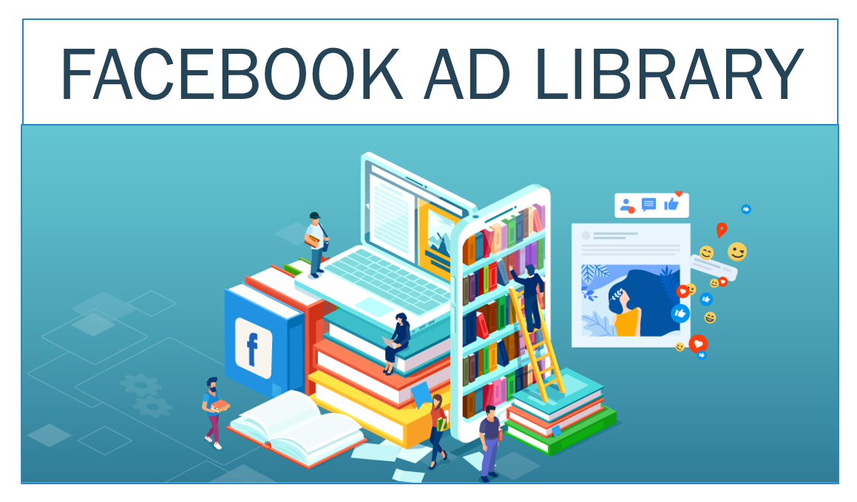
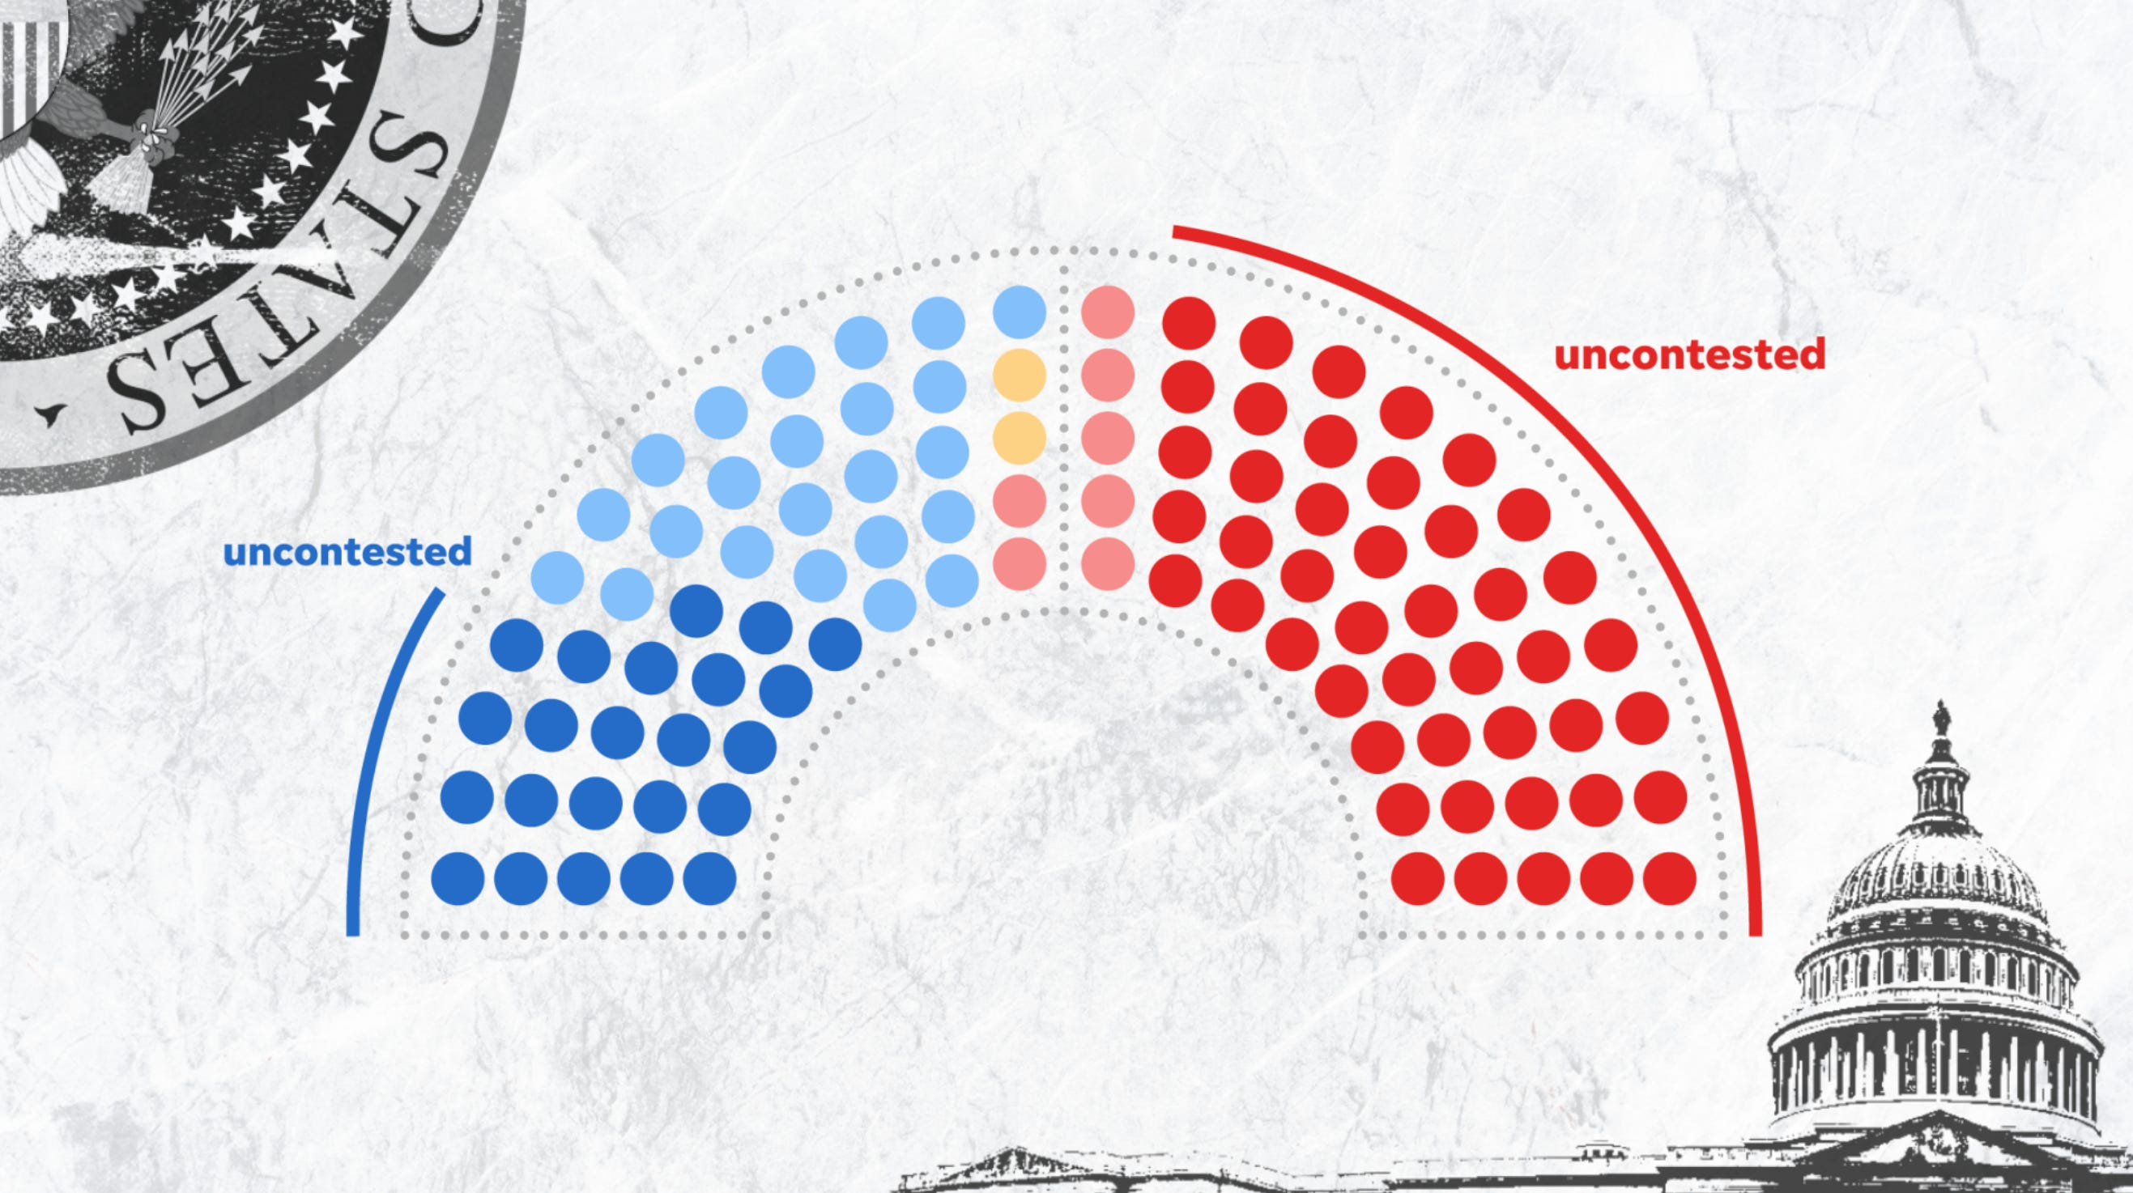
I examine Facebook ad spending by 139 US Senate candidates in 50 states during the 2018 and 2020 campaigns.
Notes:
I focus my analysis on digital ads from Facebook because Facebook recently established a publicly-accessible online archive of every political ad run on the platform.
Using this, I examine Facebook ad spending by 139 US Senate candidates across 50 states during the last two elections.

Slide 8
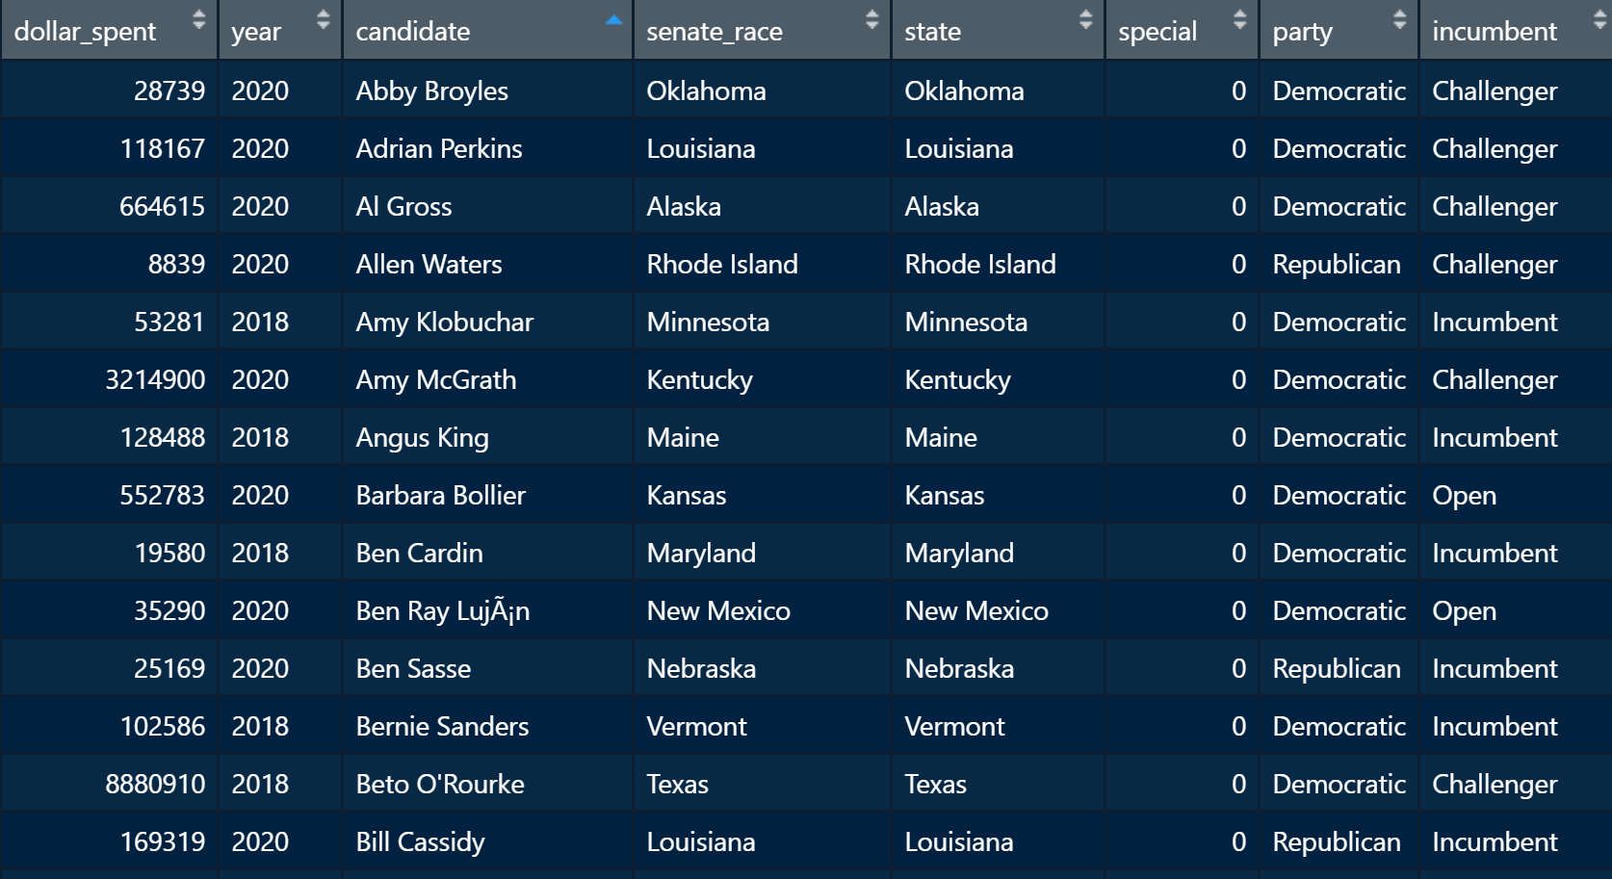
The data: 139 Observations
Response Variable: $ amount spent by each Senate candidate on Facebook ads in the four months prior to Election Day.
Predictor Variables:
Competitiveness rating
Incumbency status
Election win or lose
Special Election?
Political party
State
Year
Notes:
From the Facebook Ad Library, I collected the dollar amount spent by each Senate candidate on Facebook ads in the four month period prior to Election Day.
I added to the dataset information about the competitiveness of the Senate race taken from Cook Political Report, an organization that “rates”, based on polls, how close every electoral race is. They rate Senate races as either “safe”, “leaning toward one particular candidate over the other”, or “tossup”, which means it could go either way.
I also include data on whether the candidate was an incumbent, a challenger, or running in an open seat; whether they won or lost the election or whether it resulted in a runoff as happened in Georgia this year; whether they were competing in a special election versus a general election, which political party they belong to, and which state and which year they were running in.

Slide 9
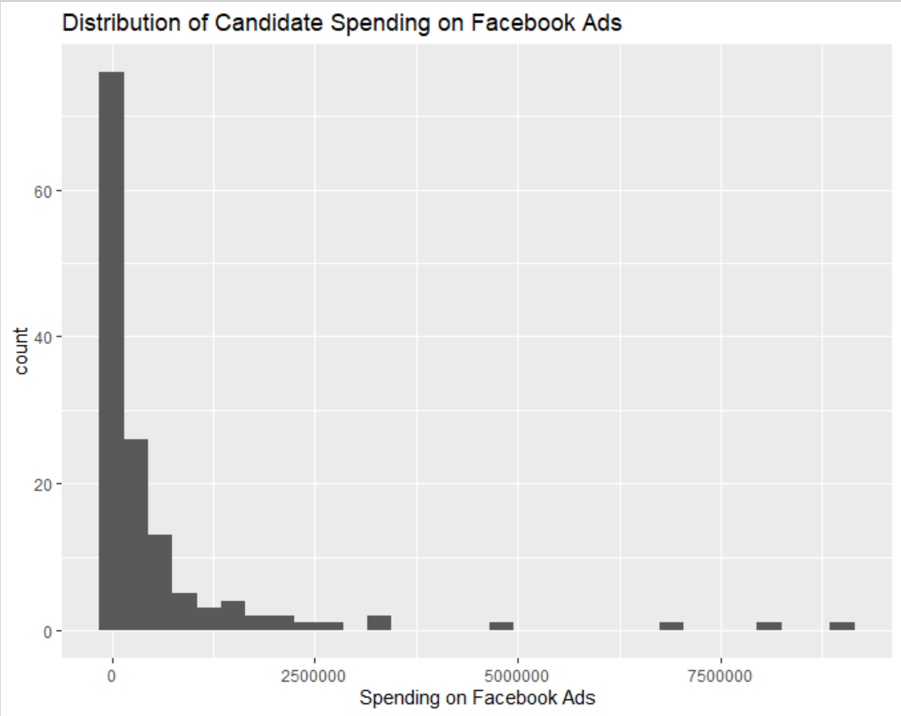
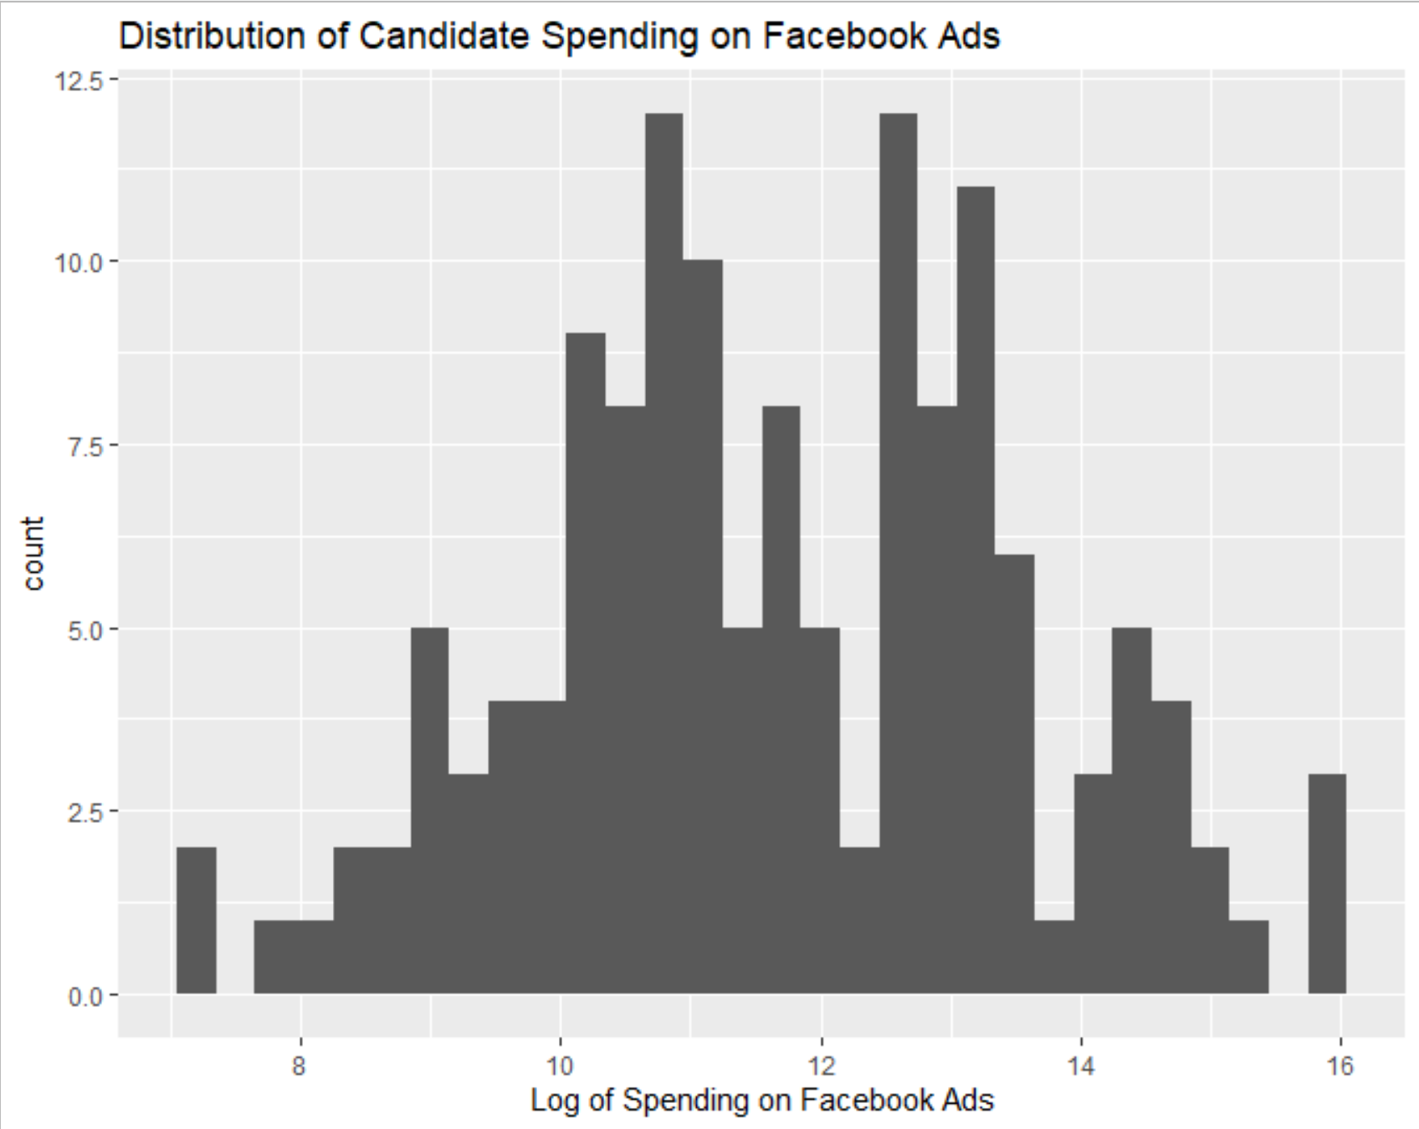
Distribution of Response Variable: Dollar Amount Spent on Facebook Ads Data analysis
LOG
Notes:
During exploratory data analysis, I first checked the distribution of dollar amount spent on Facebook ads. The distribution was heavily skewed to the right.
I transformed the response variable into the log, and this resulted in a more normal distribution.

Slide 10
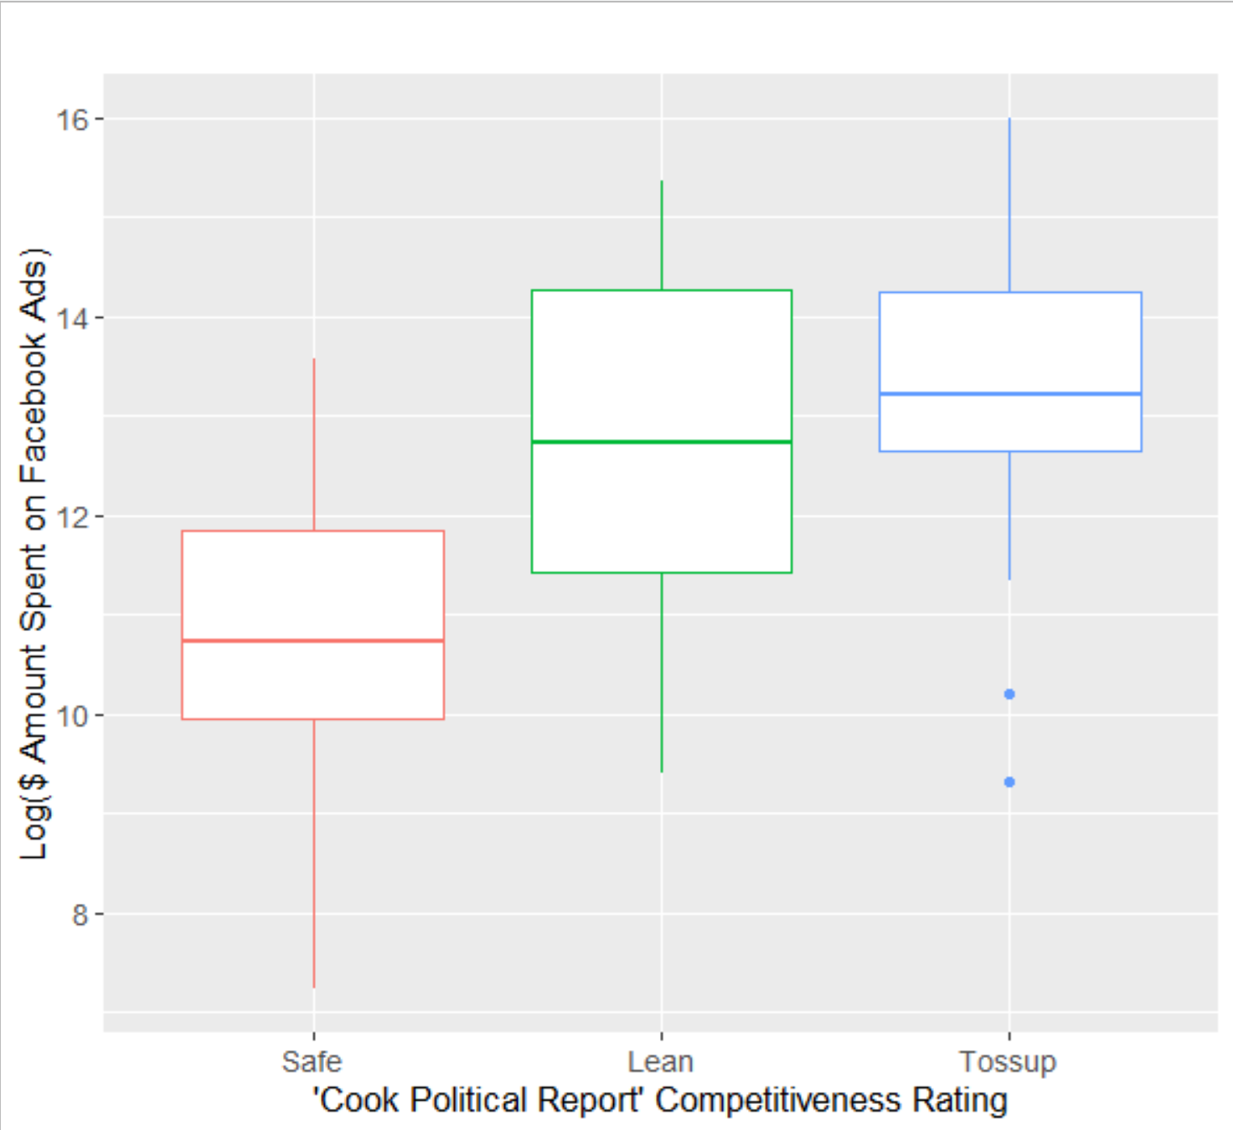
Exploratory Data Analysis: Response vs Predictor
Spending on Facebook ads is higher in races for “tossup” Senate seats versus “safe” Senate seats.
Notes:
Also during exploratory data analysis, I found that spending on Facebook ads was higher in “tossup” races (i.e. highly competitive races) versus “safe” seats.

Slide 11
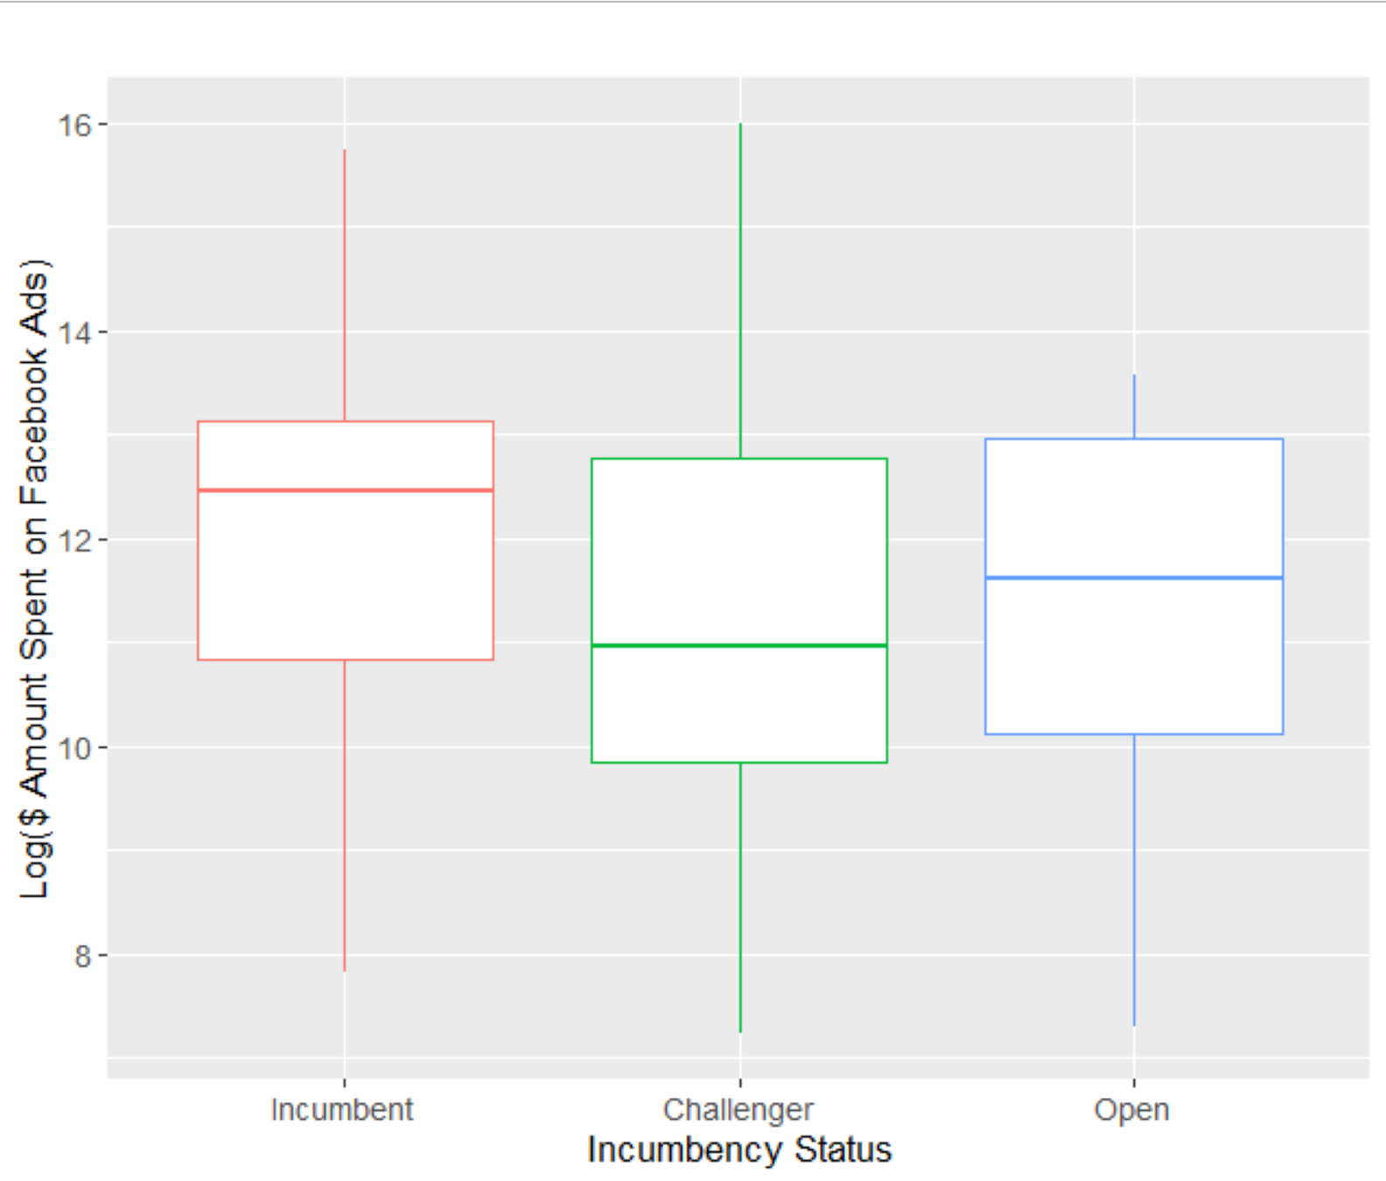
Exploratory Data Analysis: Response vs Predictor
Spending on Facebook ads is higher among incumbent candidates versus challenger candidates.
Notes:
I found that spending on Facebook ads was higher among incumbent and open seat candidates versus challenger candidates.

Slide 12
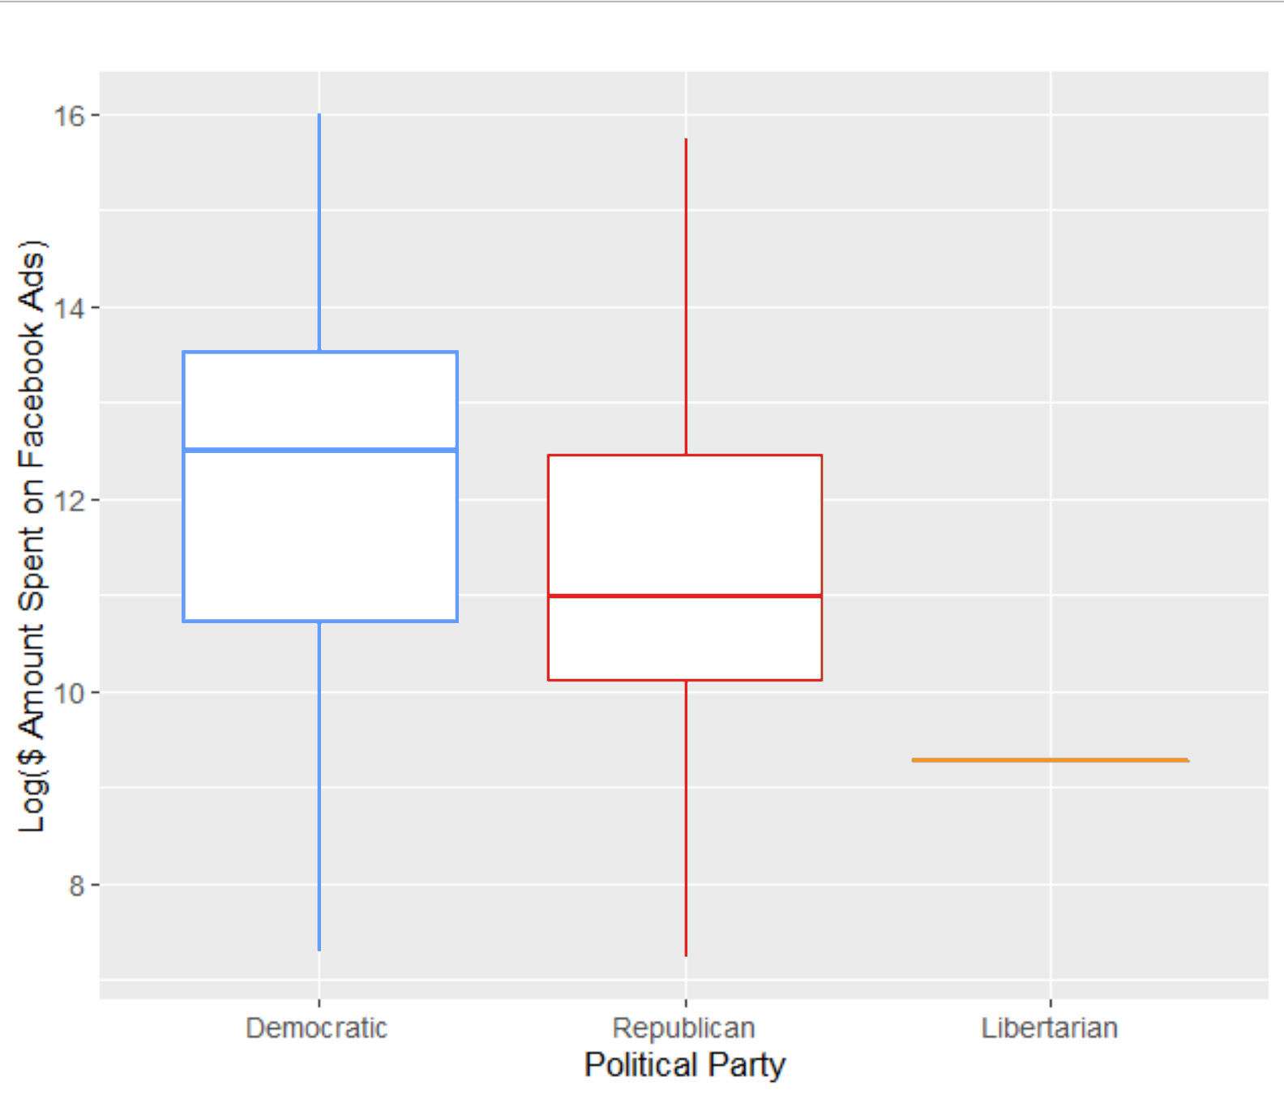
Exploratory Data Analysis: Response vs Predictor
Spending on Facebook ads is higher among Democratic candidates versus Republican candidates.
Notes:
Finally, I found that spending on Facebook ads was higher among Democratic candidates versus Republican candidates.

Slide 13
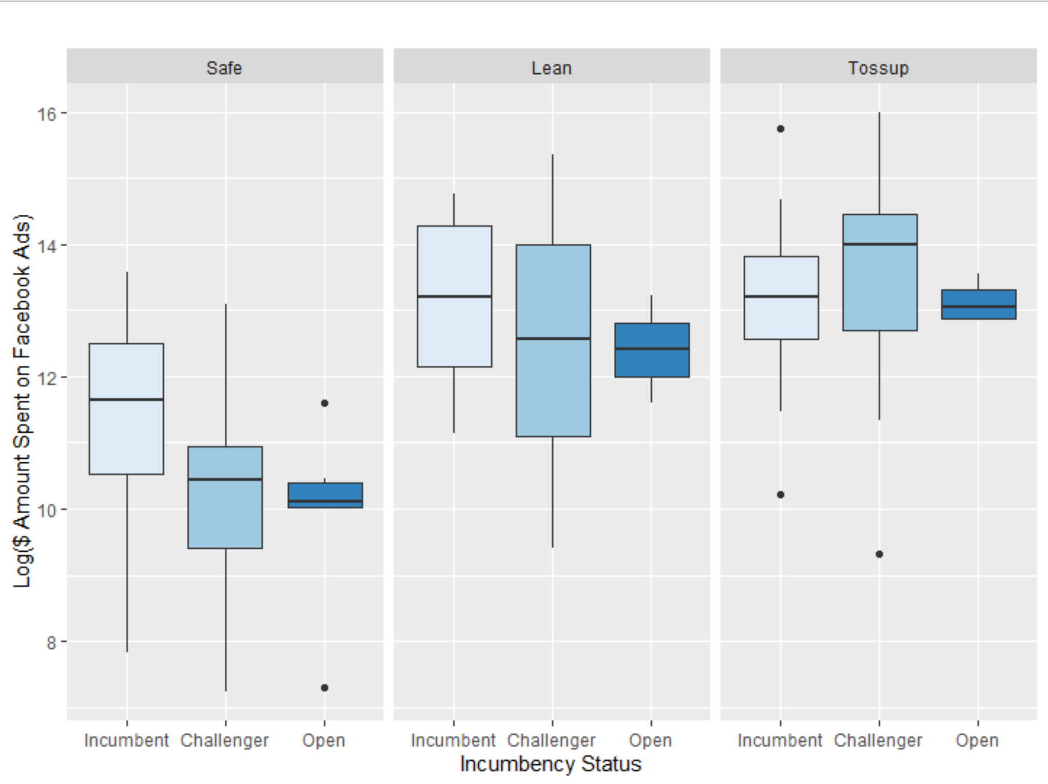
Exploratory Data Analysis: Potential Interactions
Spending on Facebook ads is higher among challengers – but only in competitive races. Otherwise, incumbents’ spending is higher.
Notes:
I also encountered some potential interactions while exploring the data.
One is that spending on Facebook ads appears to be higher among challengers – but only in competitive races.

Slide 14
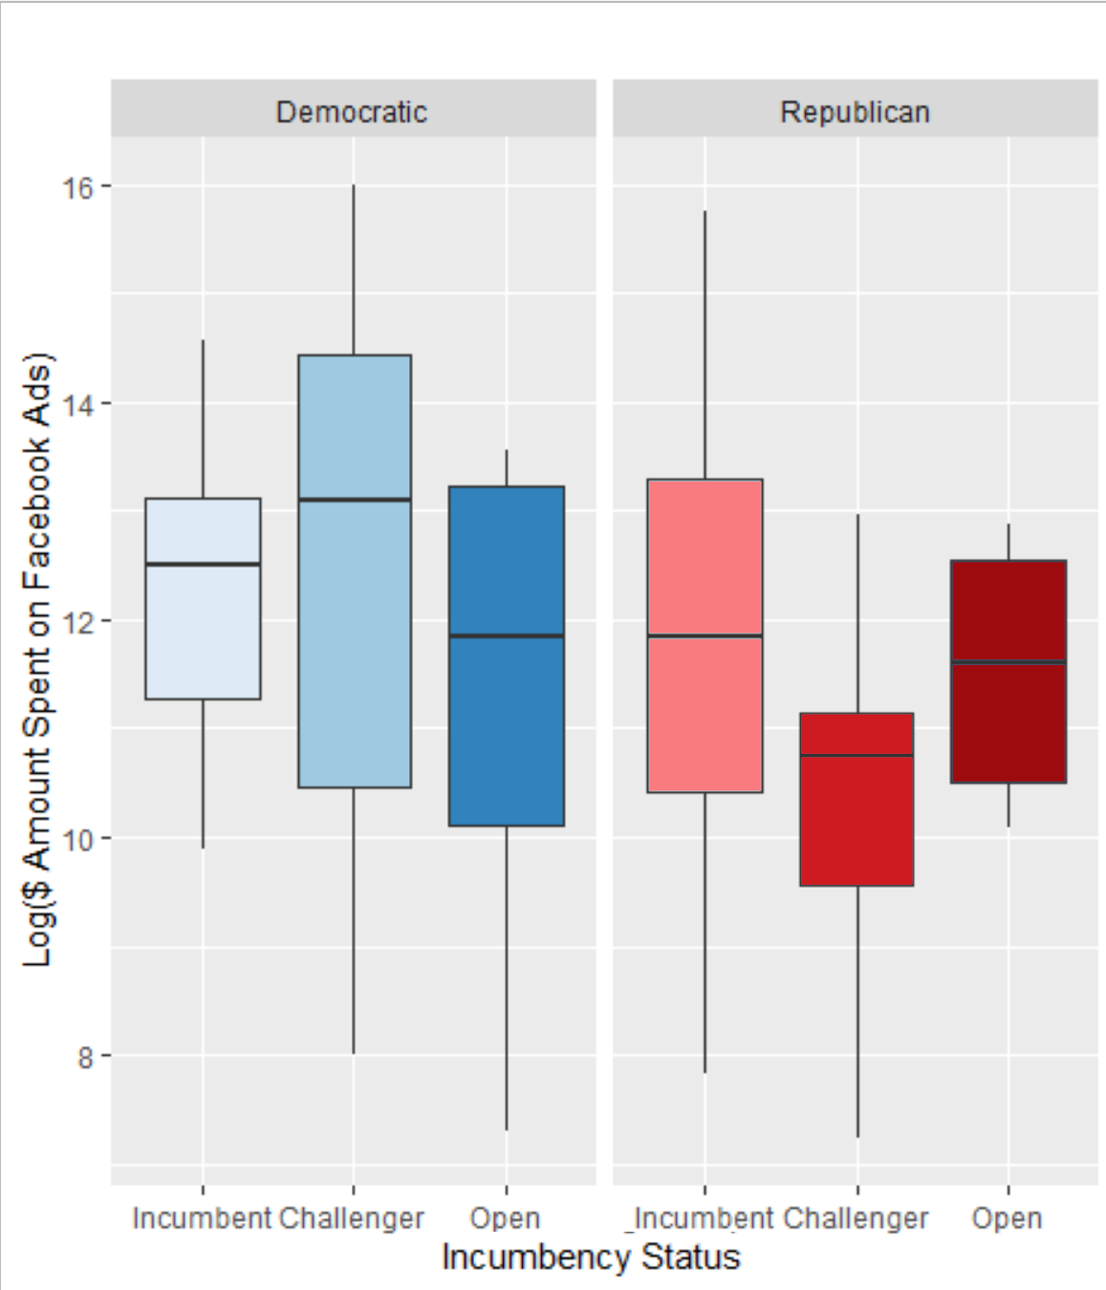
Exploratory Data Analysis: Potential Interactions
Spending on Facebook ads is higher among challengers – but only among Democratic challengers. Among Republicans, incumbents’ spending is higher.
Notes:
Another is that spending on Facebook ads appears to be higher among challengers – but only Democrats. Among Republicans, incumbent spending is higher.

Slide 15
Building a Multiple Linear Regression Model
Basic Model
Model with Interactions
Variable | Description
Year | 2018 or 2020
Party | Democratic or Republican
Special Election | No or Yes
Incumbency Status | Incumbent or Challenger or Open
Competitiveness Rating | Safe or Lean or Tossup
Election Outcome | Lost or Won or Runoff
Variable | Description
Year | 2018 or 2020
Party | Democratic or Republican
Special Election | No or Yes
Incumbency Status | Incumbent or Challenger or Open
Competitiveness Rating | Safe or Lean or Tossup
Election Outcome | Lost or Won or Runoff
Party * Incumbency Status | Democratic Incumbent vs Republican Challenger
Competitiveness * Incumbency Status | Safe Incumbent vs Lean Challenger vs Tossup Challenger
NB: Red indicates reference category
Notes:
I turn to building a linear regression model.
In my basic model, I included all main predictor variables.
I also experimented with including interactions. In this interactions model, I included the same main predictor variables plus interactions for:
-party and incumbency status AND competitiveness and incumbency status.

Slide 16



MODEL RESULTS
NB: Interactions (not shown) were not statistically significant.
Facebook advertising is still concentrated among competitive Senate races…
…but there are no significant differences between incumbents and challengers.
Notes:
What did I find?
This plot displays our log coefficient estimates.
Spending was higher in 2020 compared to 2018.
Spending was lower among Republicans compared to Democrats.
Spending was lower in open seat races and higher in more competitive seats compared to safe seats.
In other words, I found that Facebook advertising is still concentrated among competitive Senate races…. but there are no significant differences between incumbents and challengers when it comes to advertising online.

Slide 17
MODEL RESULTS
NB: Interactions (not shown) were not statistically significant.
However, Democratic candidates seem to spend significantly more on Facebook ads than their Republican counterparts.
Notes:
However, it does seem clear that Democrats spend significantly more on Facebook ads than Republicans do. My theory for why this is comes down to the overall purpose of digital ads. Digital ads are heavily focused on fundraising and securing donations. It is possible that Democrats rely on digital ads for grassroots fundraising and small dollar donations – more so than Republicans, who tend to have a network of wealthy private donors supporting them.

Slide 18
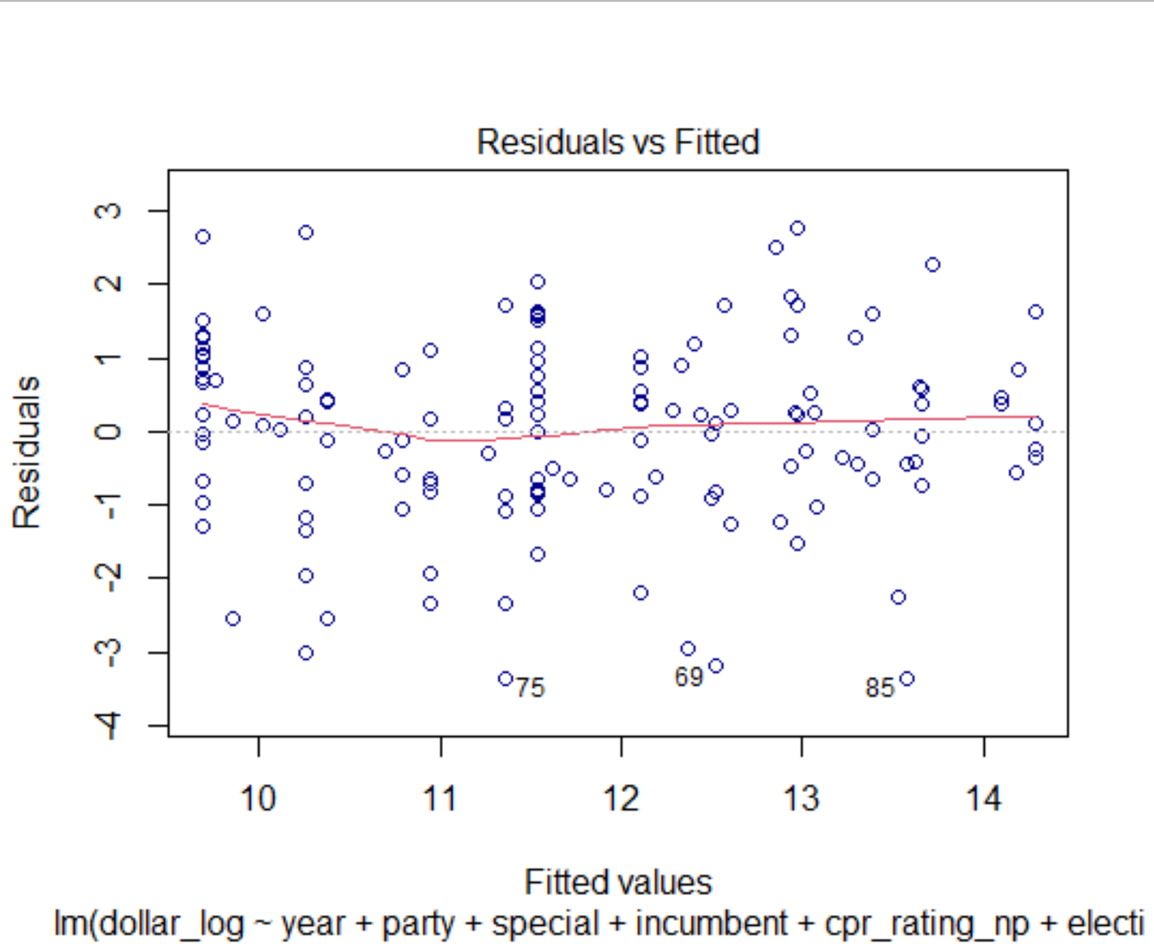
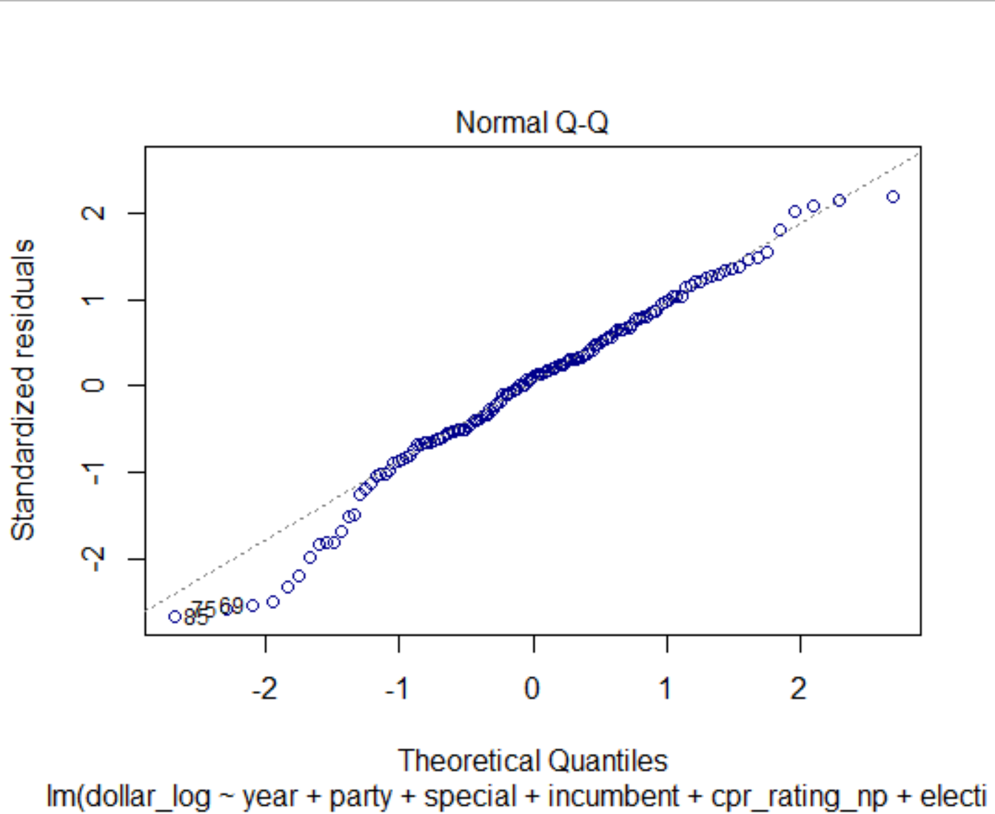
Model assessment
R²: 0.54
AIC: 490.5
Notes:
How well did my model perform?
Its adjusted R-squared was 0.54 – not bad, not great.
When looking at a residuals versus fitted value plots, it appears there is some clustering of points around certain fitted values, suggesting there may be a violation of our independence assumptions.
Meanwhile, there is also some concern about our normality assumption, since we can see some deviation from the 45 degree line on a Q-Q plot.

Slide 19
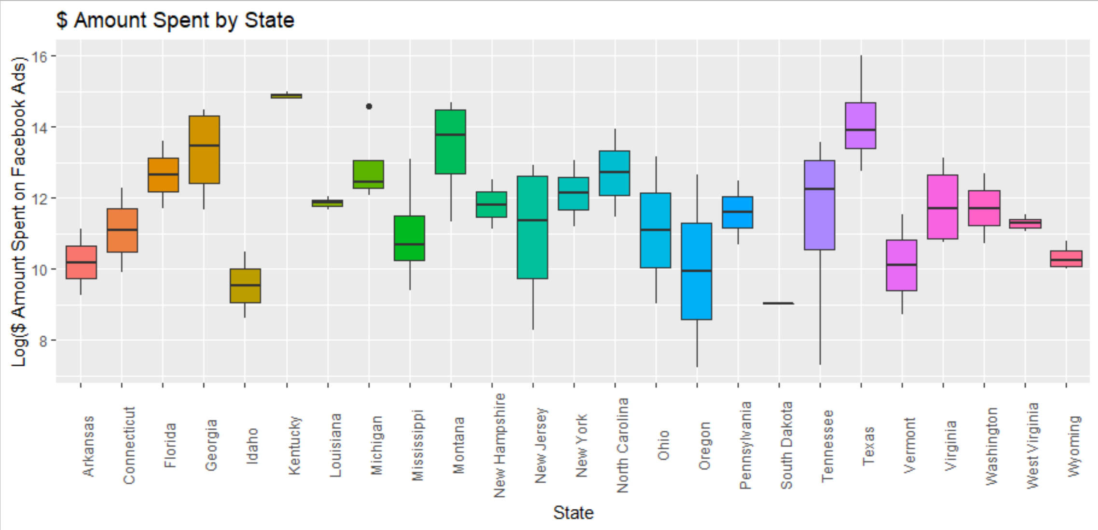
Next steps
Building a hierarchical/multilevel model to account for
variation in Facebook ad spending across states.
Notes:
Next, I plan to build on my model by including random effects for states. As can be seen from this plot, there is tremendous variation across states in terms of Facebook ad spending – so it would be useful to capture this variation in my final model.

Slide 20
Thank you for watching!
tina.tucker@duke.edu
Notes:
Thank you for watching this video – please let me know if you have any comments, questions, or feedback.

